Slide 1
PhytoPharma Co., Ltd.
305 Pia Central, 2-5-18, Choujyamachi Naka-ku
Yokohama City, 231-0033 Japan
URL: https://www.phytopharma.co.jp
Notes:
I would like to thank Dr. Debjani（テブジャニ） for inviting me to this conference and Professor Pulok（プロック） for his recommendation.
Also like to thank Mr. Watanabe of TMH Green for all his support.
My name is Watanabe from PhytoPharma.
This may be a slightly different topic than what you are talking about,
but I hope you will feel comfortable listening.
Today, I would like to introduce how we, as a Japanese company, are working on developing functional foods.

Slide 2
What is Phytopharma Co., Ltd. ?
Phytopharma Co., Ltd. has been manufacturing and selling plant-derived functional food and cosmetic ingredients both domestically and internationally for over 23 years.
By partnering with overseas raw material suppliers and sharing our technical know-how, we are working to develop high-quality, safe new products for customers around the world.
We also work on the functionality of ingredients and the development of supplement formulations, and conduct joint research with universities and other research institutions to obtain scientific evidence.
Notes:
PhytoPharma has been manufacturing and selling plant-derived functional food and cosmetic ingredients both domestically and internationally for over 23 years.
By partnering with overseas raw material suppliers and sharing our technical know-how, we are working to develop high-quality, safe new products for customers around the world.
We also work on the functionality of ingredients and the development of supplement formulations, and conduct joint research with universities and other research institutions to obtain scientific evidence.

Slide 3
Item | Product Specifications | Origin | Biological Function
Bilberry Extract | Anthocyanin ≧ 36 % Anthocyanidin ≧ 25 % | Wild Blueberry | Eye care, blood flow, beautiful skin, antioxidant, cold sensitivity,
Black soybean Hull Extract | Anthocyanin ≧ 25 % | Black soybean | Eye care, liver, blood flow, whitening, antioxidant, swelling
Sesamin-90 | Sesamin ≧ 90 % | Sesame | Liver, lipid metabolism, cholesterol, high blood pressure, cancer prevention, hangover prevention
Marigold pigment oil 【Lutein Zeaxanthin】 | Lutein ≧ 20 %, Zeaxanthin ≧ 0.8 % | Marigold | Eye care, skin care, antioxidant
Milk thistle Extract 【Silymarin】 | Silymarin ≧ 70 % | Milk thistle | Liver, beautiful skin
Phosphatidylserine-50 【Phosphatidylserine】 | Phosphatidylserine ≧ 50 % | Soybean | Brain function
Tocotrienol γ-rich T3 | Tocotrienol ≧ 65 % Tocopherol + Tocotrienol ≧ 92 % | Oil palm | Arteriosclerosis, cholesterol, high blood pressure,anti-cancer, allergy suppression
CoenzymeQ10 | CoenzymeQ10 ≧ 98 % | Microbial fermentation | Beautiful skin, immunity, anti-aging, antioxidant, immunity
Fish oil 【ω3】 | EPA ≧ 36 %, DHA ≧ 26 % | Bonito, Sardines | Hyperlipidemia, brain function, antidepressant, anti-inflammatory
Nicotinamide mononucleotide 【NMN】 | Nicotinamide mononucleotide ≧ 98 % | Microbial fermentation | Anti-aging, exercise function, mitochondrial function
5-aminolevulinic acid 【5-ALA】 | 5-aminolevulinic acid ≧ 98 % | Microbial fermentation | Anti-diabetic, fat burning, beautiful skin
Ergothioneine 【EGT】 | Ergothioneine ≧ 98 % | Microbial fermentation | Antioxidant, neuroprotection, brain function
Notes:
This table shows only a portion of the products we currently handle, which are mainly imported from overseas as raw materials or extracts, and in some cases are further refined and processed in Japan.
Some of our extracts are mainly derived from plants, but recently many are produced through fermentation.
We currently handle over 100 extract products.
Changing the subject a bit, it was around the 1970s that Japan began to be recognized around the world as a country with a long life expectancy.

Slide 4
Average life expectancy around the world
Ranking | Country name | Average life expectancy
1 | Japan | 84.3
2 | Switzerland | 83.4
3 | South Korea | 83.3
4 | Singapore | 83.2
5 | Spain | 83.2
6 | Cyprus | 83.1
7 | Australia | 83.0
7 | Italy | 83.0
9 | Israel | 82.6
9 | Norway | 82.6
117 | India | 70.8
185 | Lesotho | 50.7
Average |  | 73.0
Ranking | Country name | Average life expectancy
1 | Japan | 84.46
2 | Singapore | 83.86
3 | South Korea | 83.80
4 | Switzerland | 83.33
5 | Australia | 83.10
6 | Norway | 82.88
7 | Luxembourg | 82.78
8 | Spain | 82.66
9 | Sweden | 82.66
10 | Iceland | 82.58
133 | India | 67.50
185 | Lesotho | 51.48
Average |  | 71.40
References: WHO (2022)
References: WHO (2025)
Notes:
In fact, according to a WHO report, Japan has maintained the world's highest life expectancy for over 10 years.
In India, life expectancy has been declining slightly in recent years, perhaps due in part to the impact of COVID-19.

Slide 5
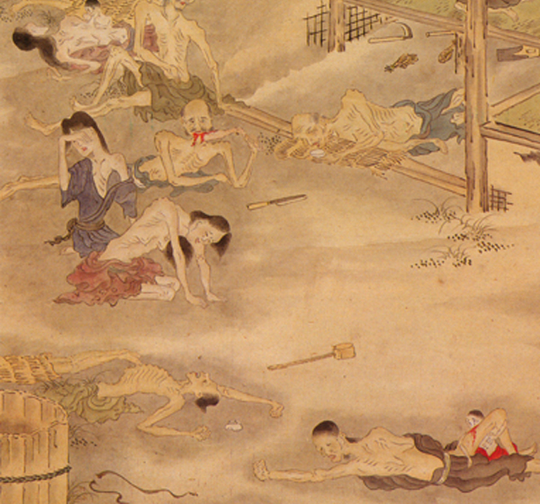
Changes in the average life expectancy of Japanese people
1999
1965
Development of agricultural technology and improvement of public health
1947
1935
1912
Mortality rates for children up to age two are high due
to malnutrition and infectious diseases !
Notes:
This graph shows changes in average life expectancy in Japan.
Japan has seen a rapid increase since the early 1900s.
Part of this is thought to be due to the end of national isolation in 1854, which led to advances in agricultural and medical technology.
We can see that the rate of increase has slowed since 2000.
Meanwhile, in recent years, there has been growing interest in Japan in healthy life expectancy, rather than simply life expectancy.
If we expand the graph from 2000 onwards and add healthy life expectancy to it,
we get this:

Slide 6
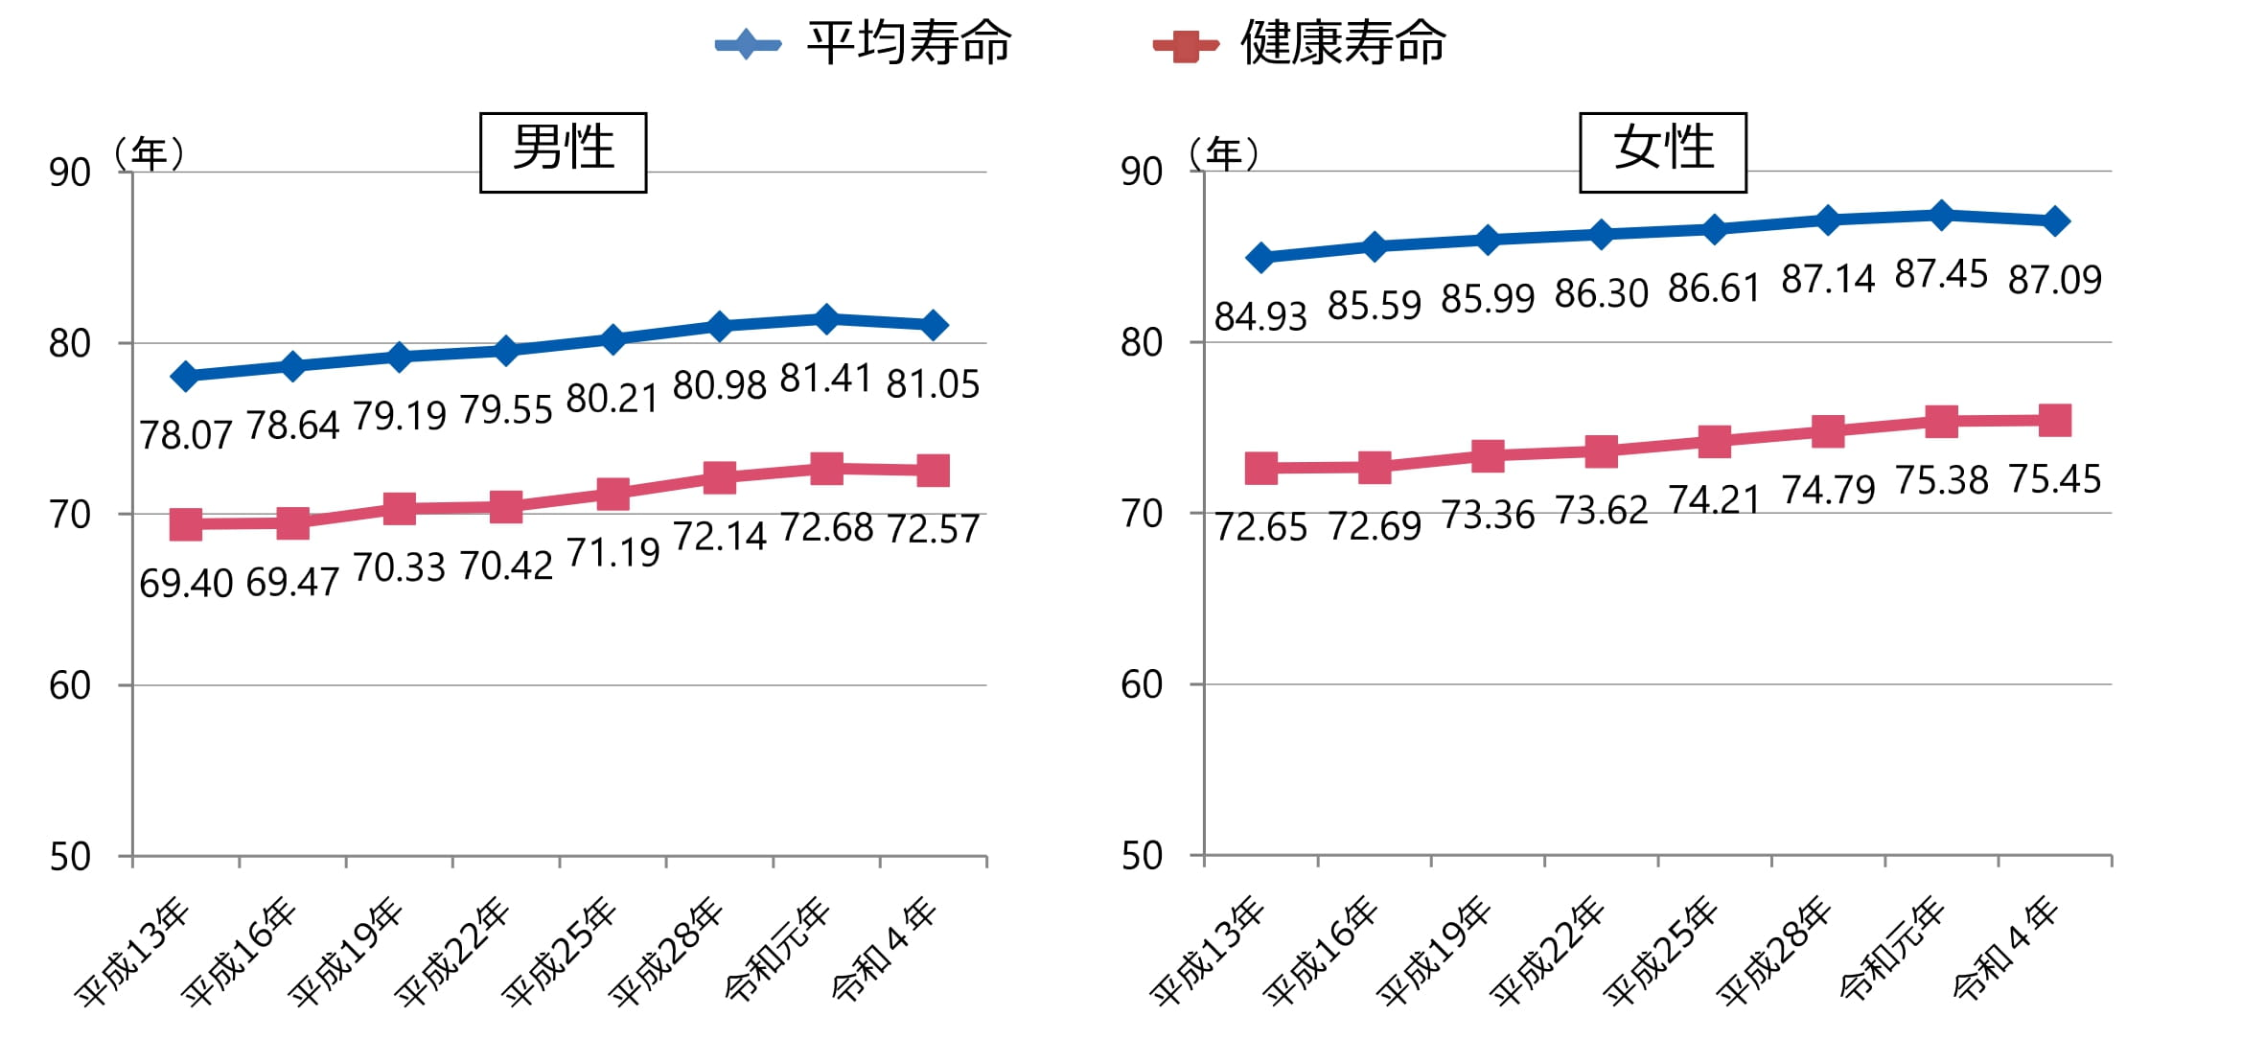
Trends in average life expectancy and healthy life expectancy of Japanese people
life expectancy
healthy life expectancy
Age
MALE
Age
FEMALE
11.64
12.28
8.48
8.67
2001
2004
2007
2010
2013
2016
2019
2022
2001
2004
2007
2010
2013
2016
2019
2022
References: Ministry of Health, Labour and Welfare
Notes:
Since 2000, the lines for average life expectancy and healthy life expectancy have remained parallel.
Ideally, they would be the green lines.
This is one of the reasons why food functionality has attracted attention in Japan, and there is currently a lot of interest in anti-aging.
Probably in the near future, it will also attract attention in India.
Therefore, I think the current situation in Japan is a good clinical model for anti-aging.

Slide 7
A person's life
Stay healthy and live a long life!
Maintaining and improving QOL
Social life level
Need for nursing care
Decrease
Bedridden
0
50
100
Age
Notes:
For example, if our hypothetical lifespan is 100 years,
the blue line would be ideal.
To achieve this, prevention is key, rather than treatment after illness has occurred.
Extracts from a variety of plants have been researched to date, and many of these materials have contributed to people's health, and I believe this will continue in the future.
Therefore, we believe that it would be more effective to supplement the components in the body that decrease with age, create a state of increased bioenergy, and then ingest biofunctional materials such as polyphenols, and we are currently conducting verification of this.

Slide 8
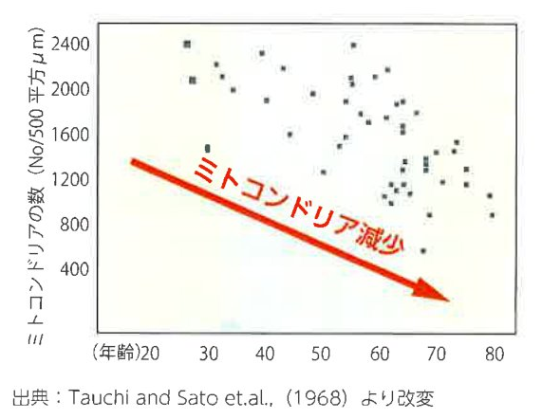
The number of mitochondria
The number of mitochondria (No/500 square μm)
Decreased number of mitochondria
Age
Ref. Tauchi and Sato et. al., (1968)
Notes:
As shown in the figure, the number of mitochondria, which are the source of energy, decreases with age.
And more cellular homeostasis can not be maintained.

Slide 9
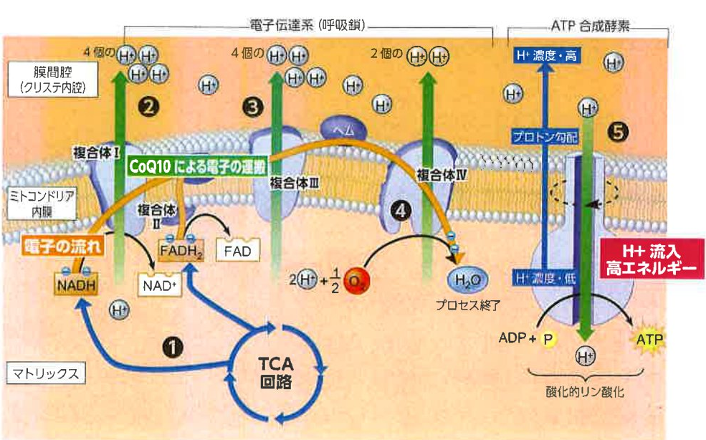
Electron transport chain and ATP synthesis mechanism
5-ALA
NMN
CoQ10
Notes:
We are currently conducting joint research with universities, believing that activating mitochondria by supplementing with NMN, CoQ10, 5-ALA, and other biological components that decrease with age and stress, and combining this with functional ingredients extracted from plants and other sources, will be even more effective.

Slide 10
Functional Food Pairing
By pairing functional ingredients,
achieve even greater effectiveness.
Notes:
As such, I believe that it will become necessary to not only rely on the individual functionality of each component, but also to pair functional components with consideration of their mechanisms.
We are conducting research based on the idea that pairing functional ingredients can produce even greater effects.

Slide 11
Thank you for your attention.

